Slide 1

Search Engine Optimization

Slide 2
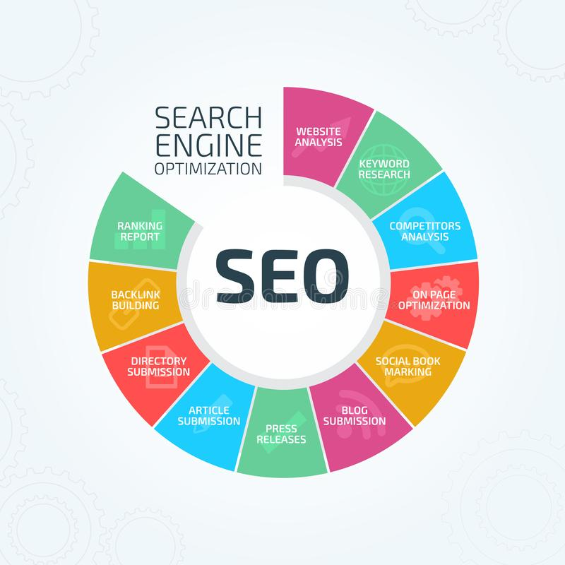
Search Engine Optimization
What is SEO?
SEO or Search Engine Optimization is the process or science (and sometimes an art in itself) of maximizing the visibility of websites in search engines.
Search Engine optimization is the process of maximizing the number of quality visitors to a website by ensuring the high rank in the list of organic results returned by a search engine.

Slide 3
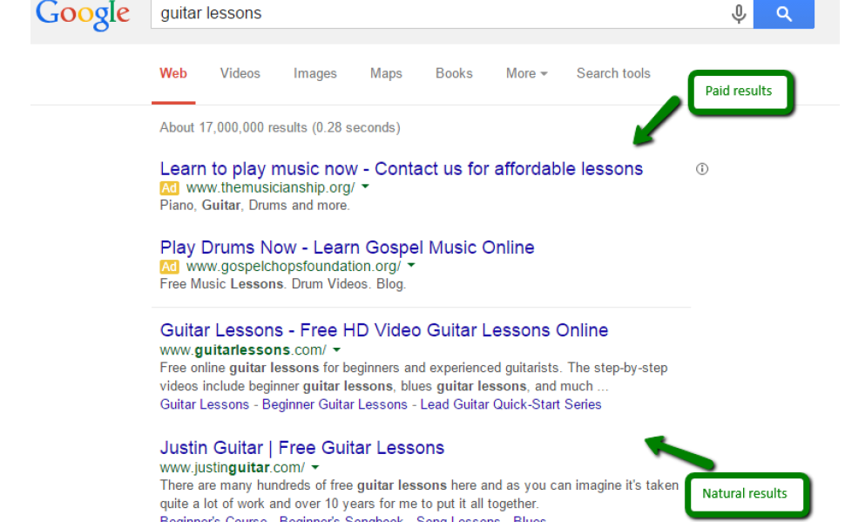
Search Engine Optimization

Slide 4
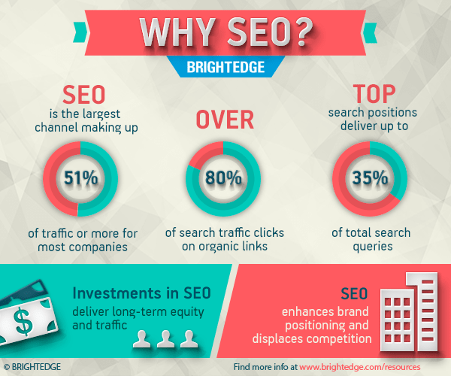
Search Engine Optimization
Why it matters?
To generate traffic,
Get recognition and
Build interest for your website through social media, advertising and other forms of traffic to attract visitors to a website.
Search engines are the backbone of any website’s publicity and visibility
Why SEO Is Important and a Huge Opportunity | BrightEdge

Slide 5
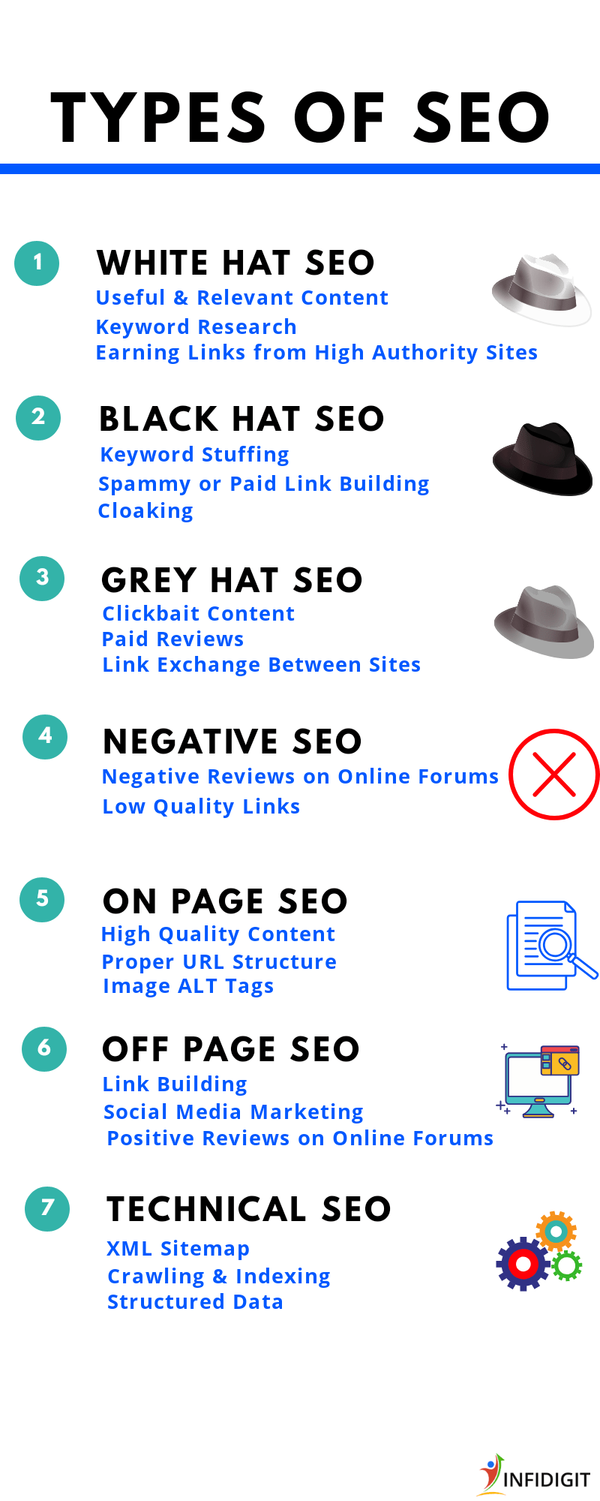
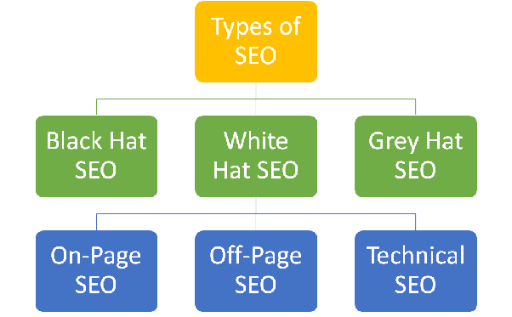
Types of SEO
Types Of SEO: 7 Different Types of SEO In Digital Marketing (infidigit.com)

Slide 6
Types of SEO
White hat SEO
The term "white hat SEO" refers to SEO tactics that are in line with the terms and conditions of the major search engines, including Google.
maintaining the integrity of your website
and staying within the search engines' terms of service.
These tactics stay within the bounds as defined by Google. Examples of white hat SEO include:
Offering quality content and services
Fast site loading times and mobile-friendliness
Using descriptive, keyword-rich meta tags
Making your site easy to navigate
White Hat tactics include using
keywords,
back-linking,
link building,
writing content that focuses on relevancy, organic ranking and audience engagement

Slide 7
Types of SEO
Black hat SEO
Black hat SEO refers to a set of practices that are used to increases a site or page's rank in search engines through means that violate the search engines' terms of service.
These practices are against the search engine's terms of service and can result in the site being banned from the search engine and affiliate sites.

Slide 8
Types of SEO
Black hat SEO
SEO tactics are considered black hat;
Content Automation
Doorway Pages
Hidden Text or Links
Keyword Stuffing
Reporting a Competitor (or Negative SEO)
Sneaky Redirects
Cloaking
Link Schemes
Guest Posting Networks
Link Manipulation (including buying links)
Article Spinning
Link Farms, Link Wheels or Link Networks
Rich Snippet Markup Spam
Automated Queries to Google
Creating pages, subdomains, or domains with duplicate content
Pages with malicious behavior, such as phishing, viruses, trojans, and other malware

Slide 9
Types of SEO
Grey Hat SEO
Gray Hat SEO is an SEO practice that's riskier than White Hat SEO, but one that may or may not result in your site being banned from search engines and their affiliate sites.
Generally, Gray Hat SEO practices belong in neither the Black Hat nor White Hat category because the terms of service regarding the issue are unclear.
“The practice of tactics/techniques which remain ill-defined by published material coming out of Google, and for which reasonable people could disagree on how the tactics support or contrast with the spirit of Google’s published guidelines."

Slide 10
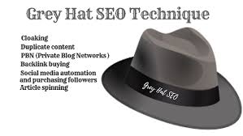
Types of SEO
Grey Hat SEO-Definition
Grey hat SEO here is a list of some of the things that are technically legal
SEO Squatting
Create Social media accounts for your pets.
Redesign your website at regular intervals
Add a comments box to your site pages and invite anyone to comment.
Link yourself higher.

